Slide 1
Data Mining DS-303
Lecture 5
Muhammad Arham
Lecturer
The University of Faisalabad

Slide 2
Content
Association Rule Mining Basics

Slide 3
Association Rule Mining

Slide 4
Introduction
There are many ways to see the similarities between items.
These are techniques that fall under the general umbrella of association.
The outcome of this type of technique, in simple terms, is a set of rules that can be understood as “if this, then that”.
Association Rule Mining is a Data Mining technique that finds patterns in data.
The patterns found by Association Rule Mining represent relationships between items. When this is used with sales data, it is referred to as Market Basket Analysis.

Slide 5
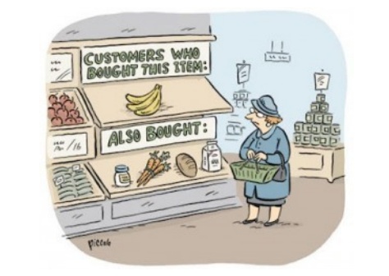
Market Basket Analysis

Slide 6
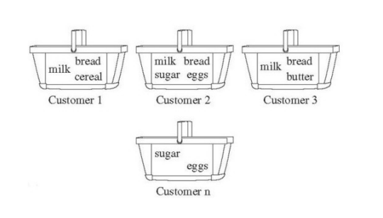
Market Basket Analysis

Slide 7
Application
Market Basket Analysis: It is one of the popular examples and applications of association rule mining. The technique is commonly used by big retailers to determine the association between items.
Medical Diagnosis: With the help of association rules, patients can be cured easily, as it helps in identifying the probability of illness for a particular disease.
Protein Sequence: The association rules help in determining the synthesis of artificial protein.
Its is also used for the catalog design, loss-leader analysis and many other applications

Slide 8
Working
Association rule learning works on the concepts of IF and ELSE statement, such as if A then B.
Here, the if element is called antecedent, and then statement is called as Consequent. These types of relationships where we can find out some association or relation between two items is known as single cardinality. It is all about creating rules, and if the number of items increases, then cardinality also increases accordingly. So, to measure the associations between thousands of data items, there are several metrics.
Support
Confidence
Lift

Slide 9
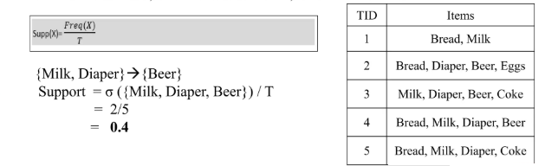
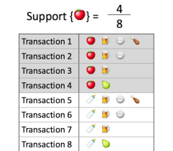
Support
Support is the frequency of A or how frequently an item appears in the dataset. It is defined as the fraction of the transaction T that contains the itemset X. If there are X datasets, then for transactions T, It can be written as

Slide 10

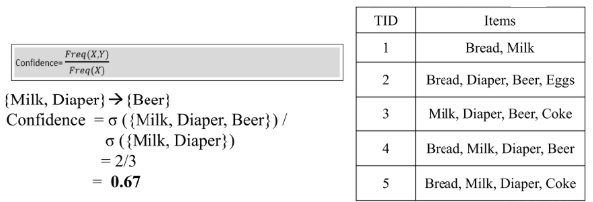
Confidence
Confidence indicates how often the rule has been found to be true. Or how often the items X and Y occur together in the dataset when the occurrence of X is already given. It is the ratio of the transaction that contains X and Y to be number of records that contain X.

Slide 11


Lift
It is the strength of any rule, which can be defined as below formula:
It is the ratio of the observed support measure and expected support if X and Y are independent of each other. It has three possible values:
If Lift =1: The probability of occurrence of antecedent and consequent is independent of each other.
Lift>1: It determines the degree to which the two itemset are dependent to each other.
Lift<1: It tells us that one item is a substitute for other items, which means one item has a negative effect on another.

Slide 12
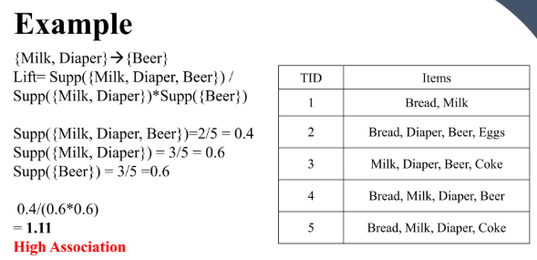

Slide 13
Conclusion
The Association rule is very useful in analyzing datasets. The data is collected using bar-code scanners in supermarkets. Such databases consists of many transaction records which list all items bought by a customer on a single purchase. So, the manager could know if certain groups of items are consistently purchased together and use this data for adjusting store layouts, cross-selling, promotions based on statistics.

Slide 14
Reference
https://www.slideshare.net/slideshow/association-rule-mining-4f54/264237851
https://www.slideshare.net/slideshow/association-rule-miningpptx/256592213#3
https://mitu.co.in/wp-content/uploads/2021/11/10.-Association-Rule-Mining.pdf

Slide 15
Advice
Kindly read the book before and after the lecture, if some terms/ words are not covered in the lecture, if appear in exam it might not appear strange or out of course.

